Slide 1
Introduction to Regression Part A - kNN

Slide 3
Lecture Outline
Part A: Statistical Modeling
k-Nearest Neighbors (kNN)
Part B: Model Fitness
How does the model perform predicting?
Part B: Comparison of Two Models
How do we choose from two different models?
Part C: Linear Models

Slide 4
Predicting a Variable
Let's image a scenario where we'd like to predict one variable using another (or a set of other) variables.
Examples:
Predicting the amount of views a YouTube video will get next week based on video length, the date it was posted, previous number of views, etc.
Predicting which movies a Netflix user will rate highly based on their previous movie ratings, demographic data etc.

Slide 5
Data
The Advertising data set consists of the sales of a particular product in 200 different markets, along with advertising budgets for the product in each of those markets for three different media: TV, radio, and newspaper. Everything is given in units of $1000.
,
TV | radio | newspaper | sales
230.1 | 37.8 | 69.2 | 22.1
44.5 | 39.3 | 45.1 | 10.4
17.2 | 45.9 | 69.3 | 9.3
151.5 | 41.3 | 58.5 | 18.5
180.8 | 10.8 | 58.4 | 12.9
Some of the figures in this presentation are taken from "An Introduction to Statistical Learning, with applications in R" (Springer, 2013) with permission from the authors: G. James, D. Witten, T. Hastie and R. Tibshirani "

Slide 6
Response vs. Predictor Variables
There is an asymmetry in many of these problems:
The variable we'd like to predict may be more difficult to measure, is more important than the other(s), or may be directly or indirectly influenced by the values of the other variable(s).
Thus, we'd like to define two categories of variables:
variables whose values we want to predict
variables whose values we use to make our prediction

Slide 7
Response vs. Predictor Variables
X
predictors
features
covariates
Y
outcome
response variable
dependent variable
TV | radio | newspaper | sales
230.1 | 37.8 | 69.2 | 22.1
44.5 | 39.3 | 45.1 | 10.4
17.2 | 45.9 | 69.3 | 9.3
151.5 | 41.3 | 58.5 | 18.5
180.8 | 10.8 | 58.4 | 12.9
n observations
p predictors

Slide 8
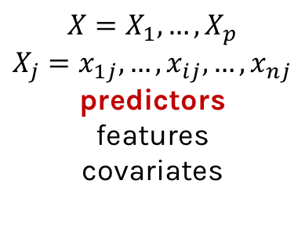
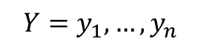
Response vs. Predictor Variables
$$X=X_{1},…,X_{p}$$
$$X_{j}=x_{1j},…,x_{ij},…,x_{nj}$$
predictors
features
covariates
outcome
response variable
dependent variable
$$Y=y_{1},…,y_{n}$$
TV | radio | newspaper | sales
230.1 | 37.8 | 69.2 | 22.1
44.5 | 39.3 | 45.1 | 10.4
17.2 | 45.9 | 69.3 | 9.3
151.5 | 41.3 | 58.5 | 18.5
180.8 | 10.8 | 58.4 | 12.9
n observations
p predictors
Notes:
I changed y_p to y_n. I think this makes the dimensions correct now. (DLS)

Slide 9
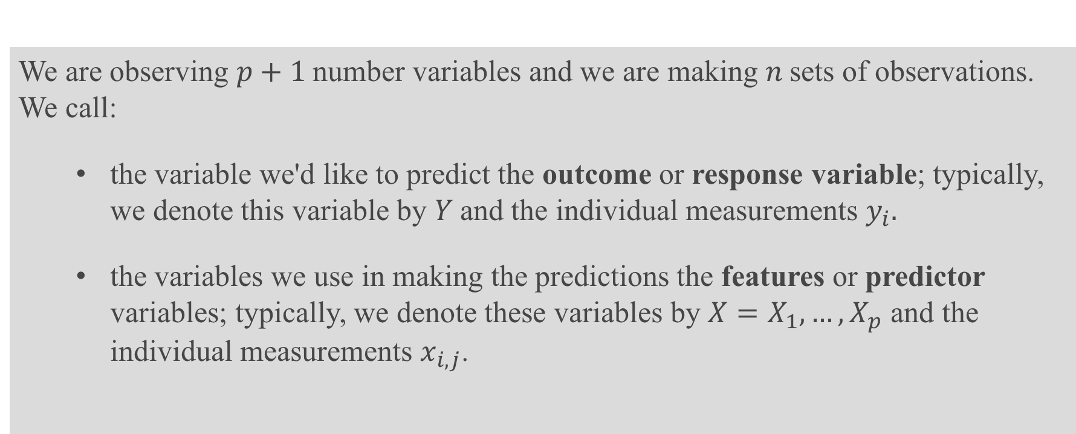
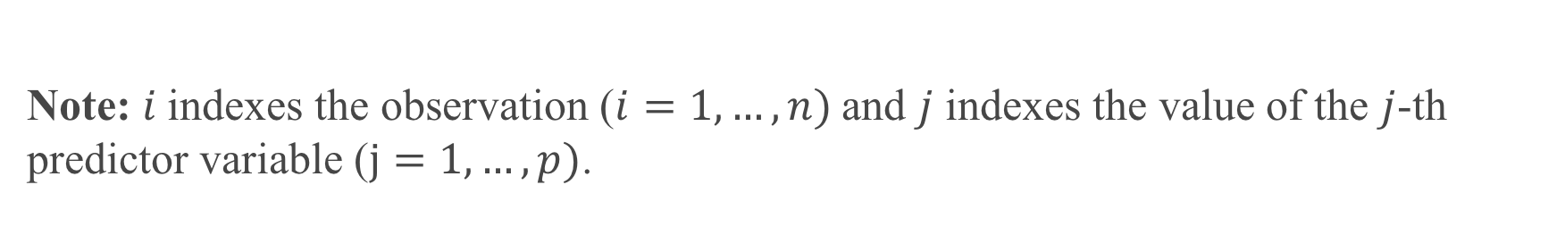
Definition
We are observing $p+1$number variables and we are making $n$sets of observations. We call:
the variable we'd like to predict the outcome or response variable; typically, we denote this variable by $Y$and the individual measurements $y_{i}.$
the variables we use in making the predictions the features or predictor variables; typically, we denote these variables by $X=X_{1},…,X_{p}$ and the individual measurements $x_{i,j}$.
Note: $i$indexes the observation ($i=1,…,n)$and $j$ indexes the value of the $j$-th predictor variable ($j=1,…,p)$.

Slide 10
Statistical Model

Slide 11
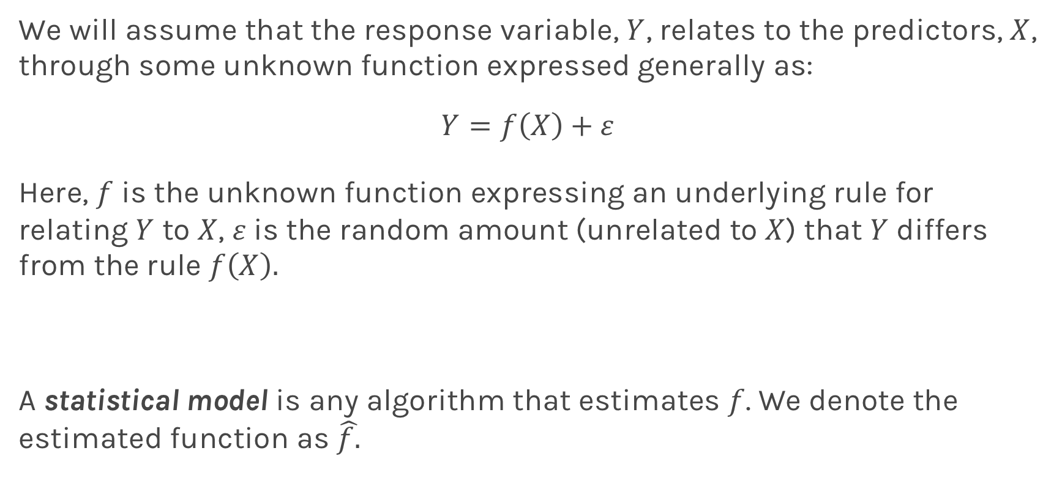
True vs. Statistical Model
We will assume that the response variable, $Y$, relates to the predictors, $X$, through some unknown function expressed generally as:
$$Y=f\left(X\right)+ε$$
Here, $f$ is the unknown function expressing an underlying rule for relating $Y$ to $X$, $ε$is the random amount (unrelated to $X$) that $Y$ differs from the rule $f\left(X\right).$
A statistical model is any algorithm that estimates $f$. We denote the estimated function as $\hat{f.}$
Notes:
Change x and y to uppercase? (DLS)

Slide 12
Example: predicting sales
Motivation: Predict Sales
Build a model to predict sales based on TV budget
The response, y, is the sales
The predictor, x, is TV budget

Slide 13
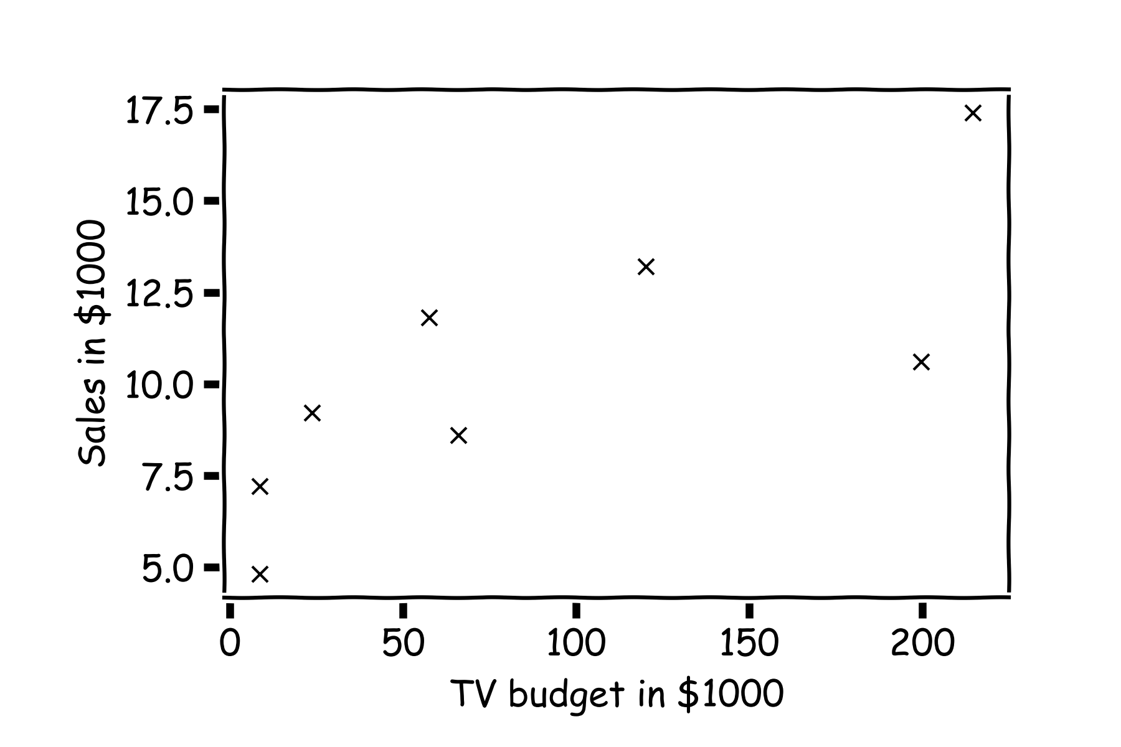
Statistical Model
y
x

Slide 14
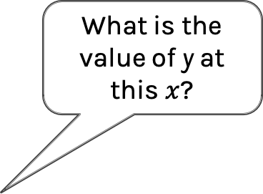
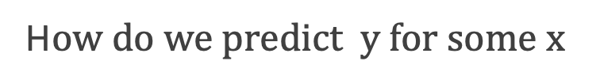
Statistical Model
H$ow do we predict y for some x$
What is the value of y at this $x$?

Slide 15
Statistical Model
H$ow do we predict y for some x$
or this one?

Slide 16
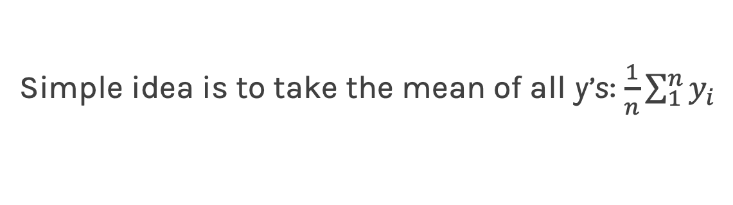
Statistical Model
Simple idea is to take the mean of all y’s: $\frac{1}{n}\sum_{1}^{n}{y_{i}}$

Slide 17
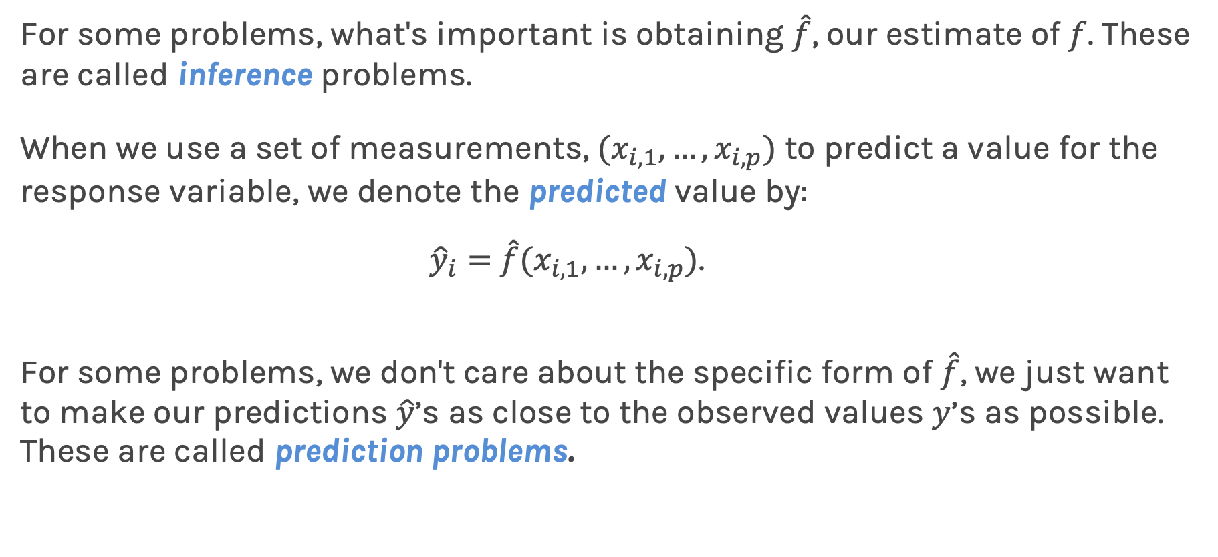
Prediction vs. Estimation
For some problems, what's important is obtaining $\hat{f}$, our estimate of $f$. These are called inference problems.
When we use a set of measurements, $(x_{i,1}, …,x_{i,p})$ to predict a value for the response variable, we denote the predicted value by:
${\hat{y}}_{i}=$ $\hat{f}(x_{i,1}, …,x_{i,p})$.
For some problems, we don't care about the specific form of $\hat{f}$, we just want to make our predictions $\hat{y}$’s as close to the observed values $y$’s as possible. These are called prediction problems.

Slide 18
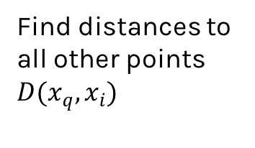
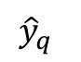
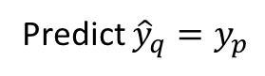
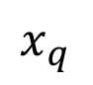
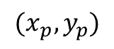
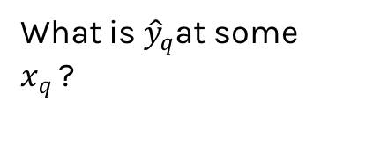
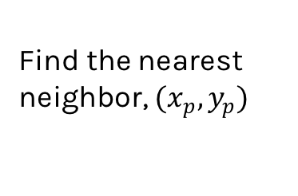
Simple Prediction Model
What is ${\hat{y}}_{q}$at some $x_{q }$?
Find distances to all other points $D(x_{q},x_{i})$
$${(x}_{p},y_{p})$$
$${\hat{y}}_{q}$$
Find the nearest neighbor, ${(x}_{p},y_{p})$
Predict ${\hat{y}}_{q}=y_{p}$
$$x_{q}$$
Notes:
Is it clear that x_q is really x_i,q? (DLS)

Slide 19
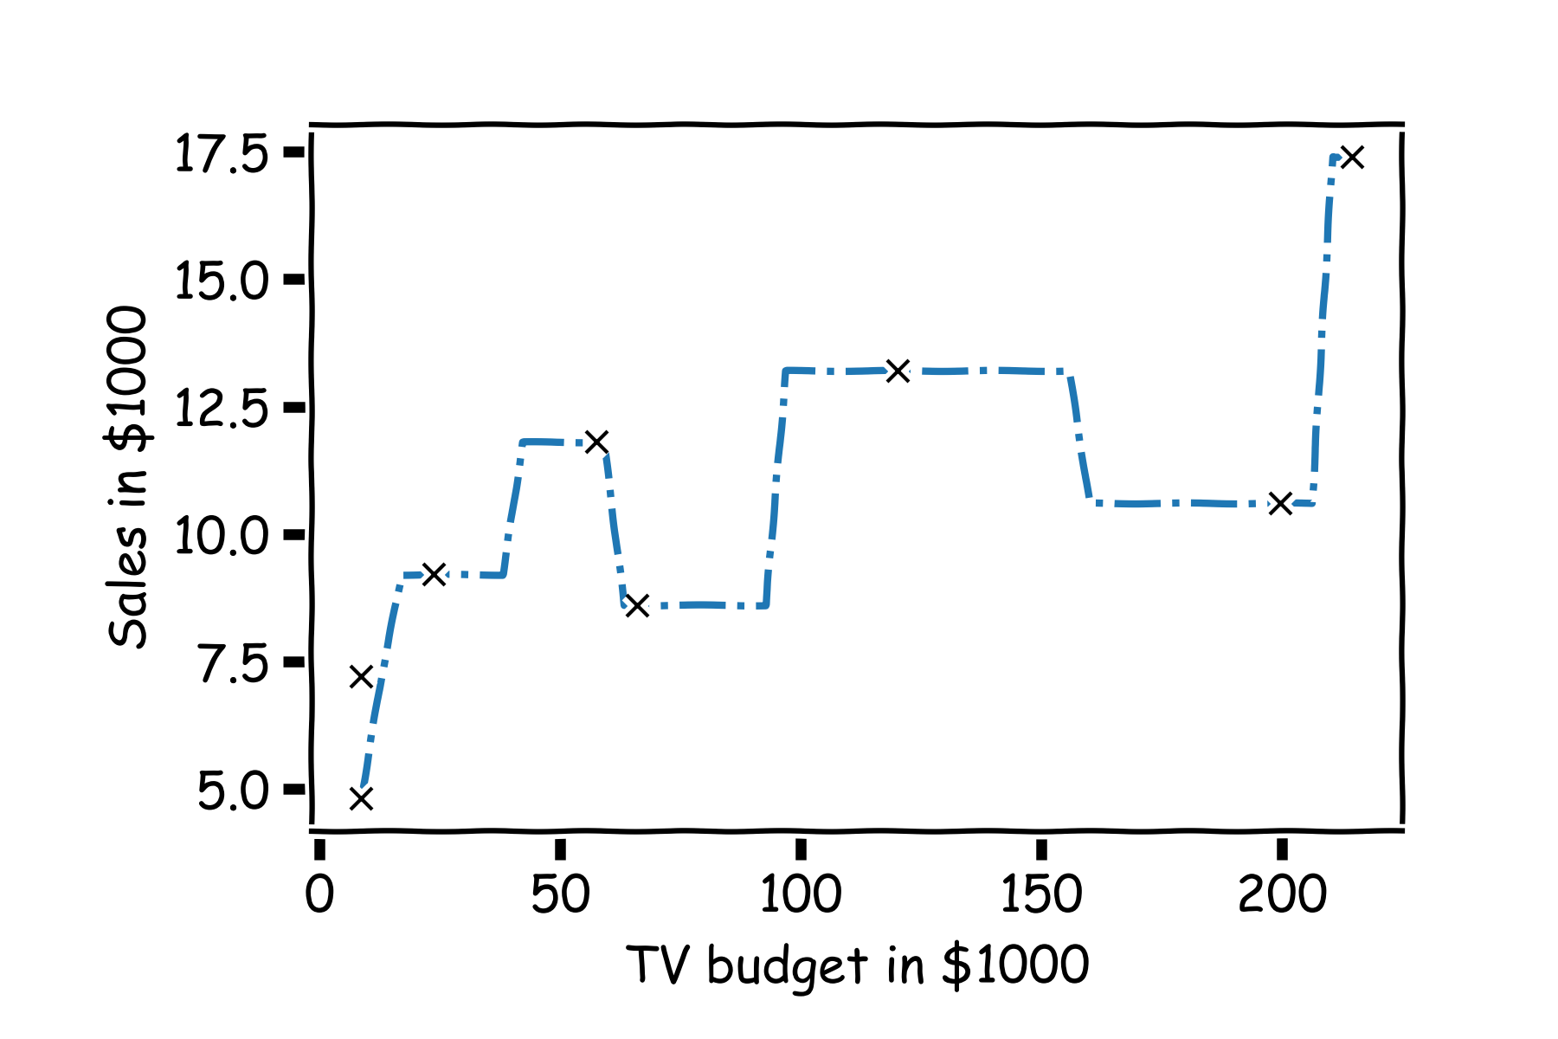
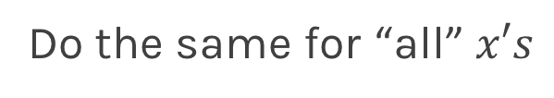
Simple Prediction Model
Do the same for “all” $x′s$

Slide 20
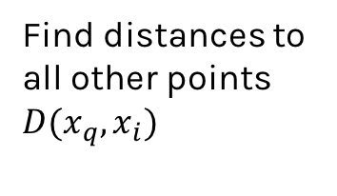
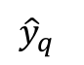
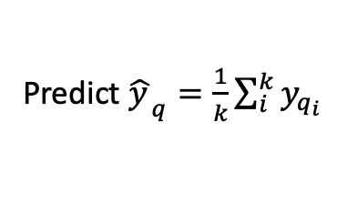
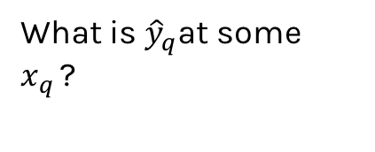
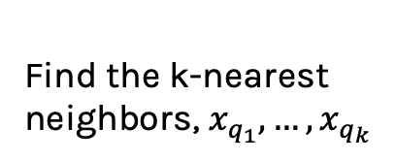
Extend the Prediction Model
What is ${\hat{y}}_{q}$at some $x_{q }$?
Find distances to all other points $D(x_{q},x_{i})$
$${\hat{y}}_{q}$$
Find the k-nearest neighbors, $x_{q_{1}},…,x_{q_{k}}$
Predict ${\hat{y_{ }}}_{q}=\frac{1}{k}\sum_{i}^{k}{y_{q_{i}}}$
$$x_{q}$$
Notes:
Change indeces and show k-nearest

Slide 21
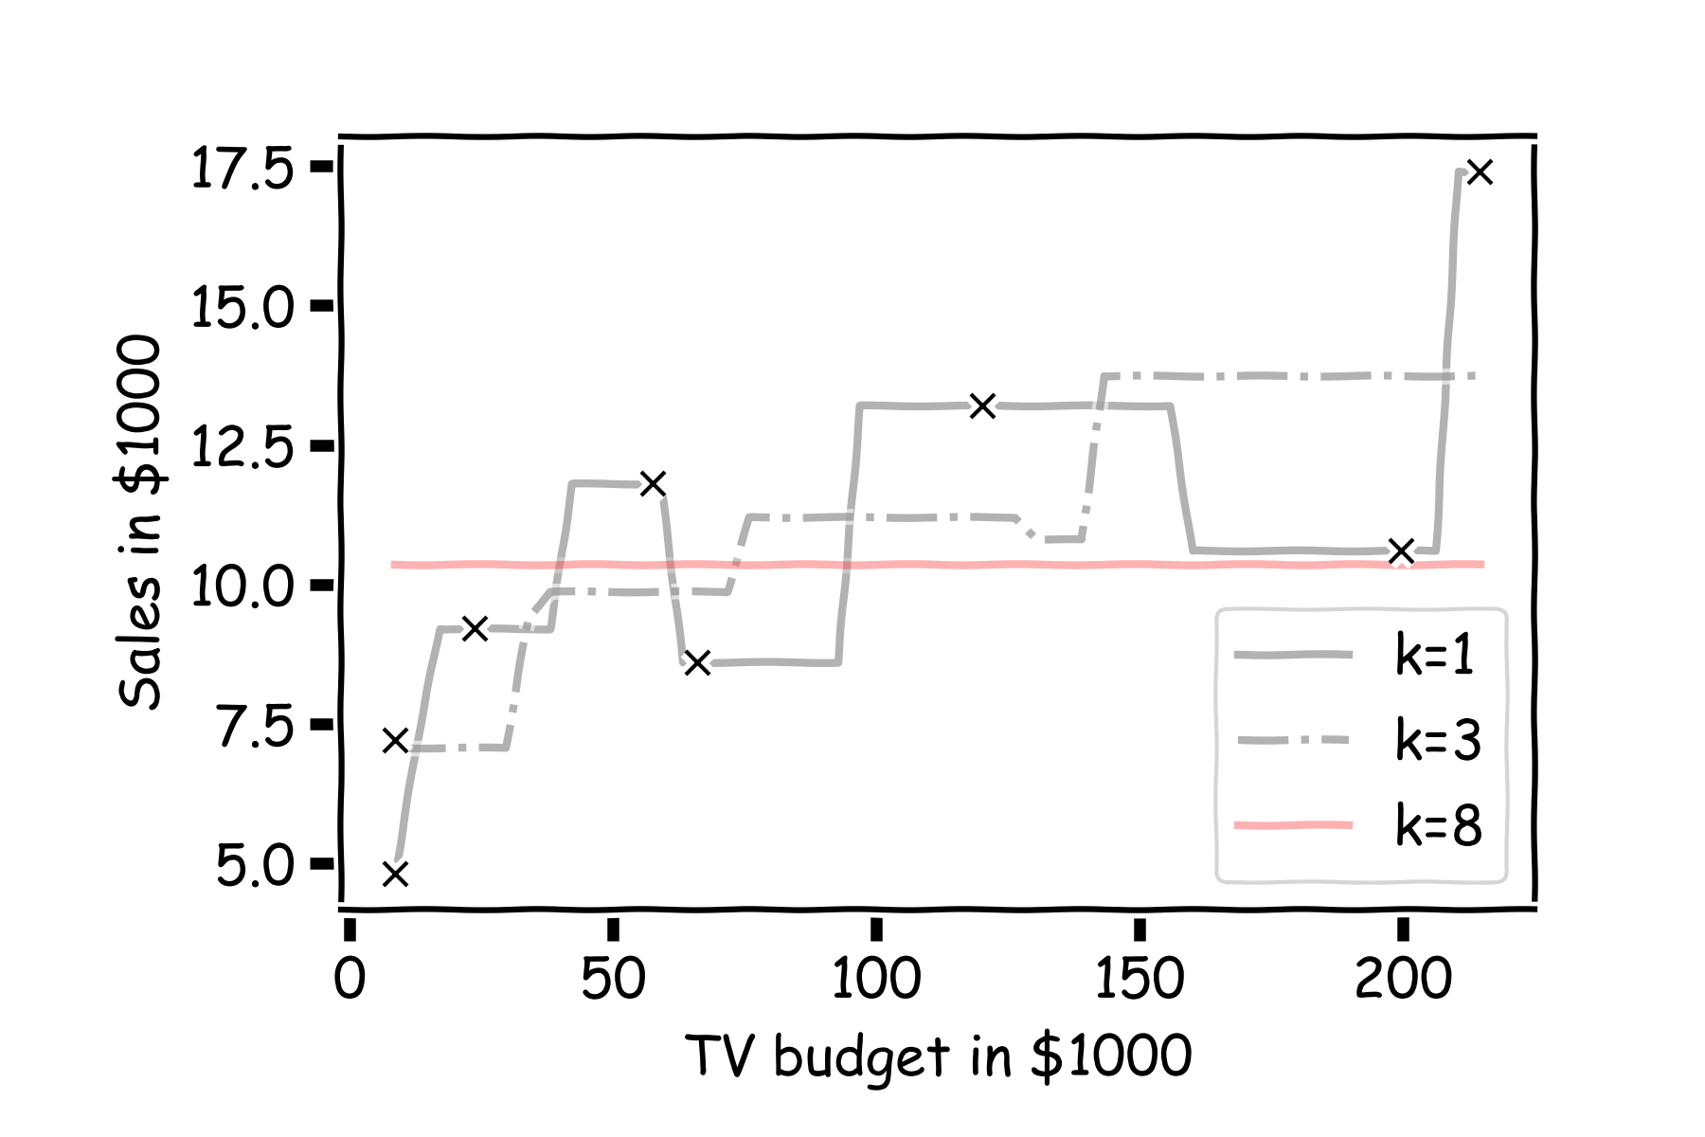
Simple Prediction Models
Notes:
Change indeces and show k-nearest

Slide 22

Simple Prediction Models
We can try different k-models on more data
Notes:
Change indeces and show k-nearest

Slide 23
k-Nearest Neighbors
The k-Nearest Neighbor (kNN) model is an intuitive way to predict a quantitative response variable:
to predict a response for a set of observed predictor values, we use the responses of other observations most similar to it
kNN is a non-parametric learning algorithm. When we say a technique is non parametric , it means that it does not make any assumptions on the underlying data distribution.
Note: this strategy can also be applied in classification to predict a categorical variable. We will encounter kNN again later in the course in the context of classification.
Notes:
Change indeces and show k-nearest

Slide 24
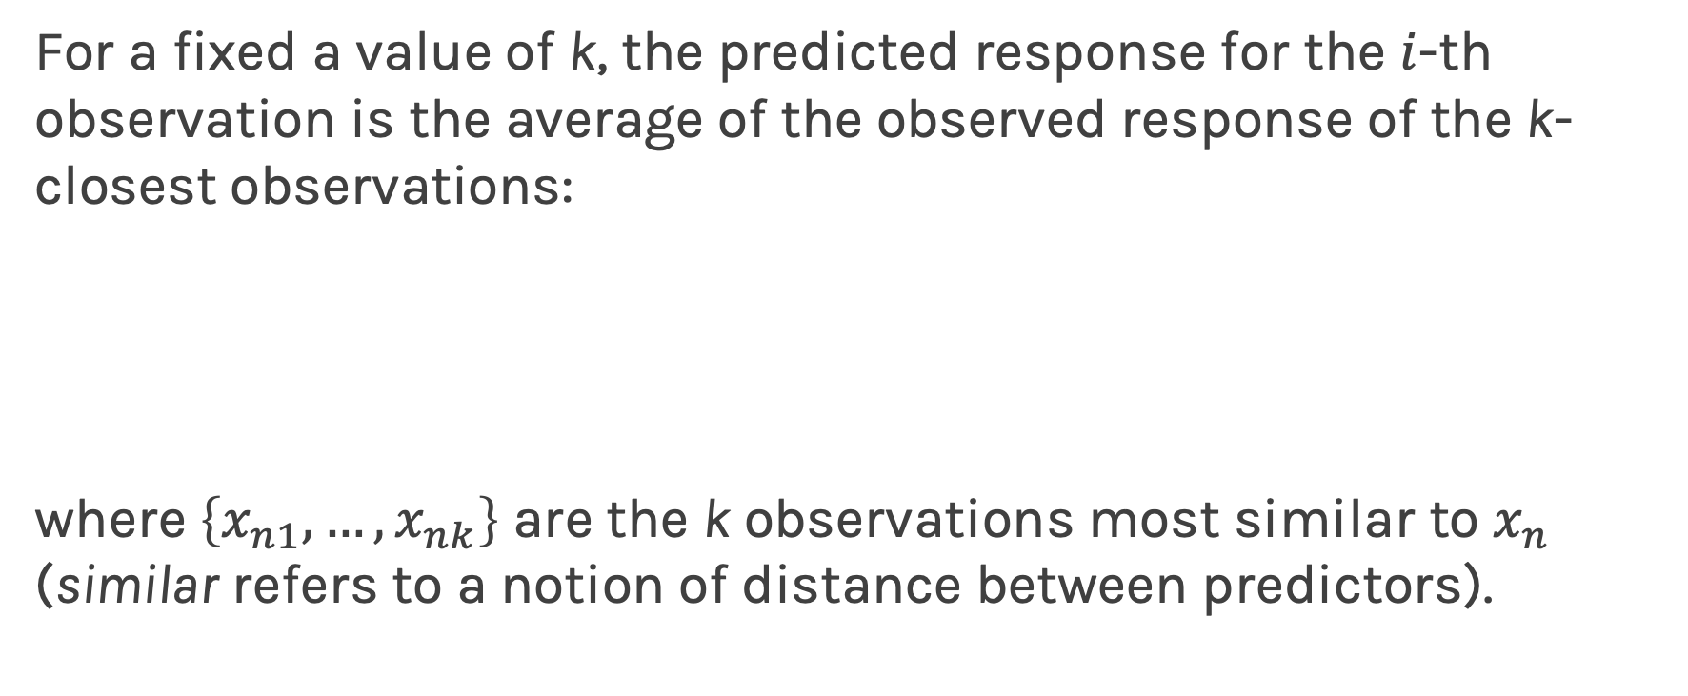
k-Nearest Neighbors - kNN
For a fixed a value of k, the predicted response for the $i$-th observation is the average of the observed response of the k-closest observations:
where $\left\{x_{n1},…,x_{nk}\right\}$ are the k observations most similar to $x_{n}$ (similar refers to a notion of distance between predictors).

Slide 25
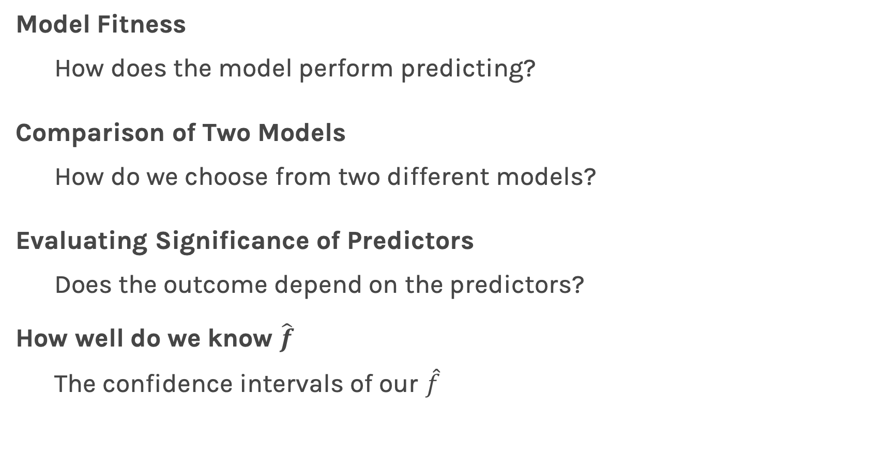
Things to Consider
Model Fitness
How does the model perform predicting?
Comparison of Two Models
How do we choose from two different models?
Evaluating Significance of Predictors
Does the outcome depend on the predictors?
How well do we know $\hat{f}$
The confidence intervals of our $\hat{f}$

Slide 26
Ex A.1, Ex A.2

